Slide 1
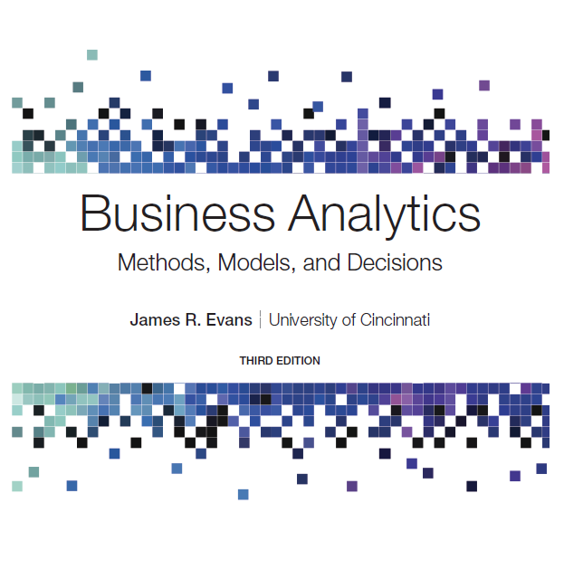
Business Analytics: Methods, Models, and Decisions
Third Edition
Chapter 5
Probability Distributions and Data Modeling
Copyright © 2020, 2016, 2013 Pearson Education, Inc. All Rights Reserved
Notes:
If this PowerPoint presentation contains mathematical equations, you may need to check that your computer has the following installed:
1) MathType Plugin
2) Math Player (free versions available)
3) NVDA Reader (free versions available)

Slide 2
Basic Concepts of Probability
Probability is the likelihood that an outcome occurs. Probabilities are expressed as values between 0 and 1.
An experiment is the process that results in an outcome.
The outcome of an experiment is a result that we observe.
The sample space is the collection of all possible outcomes of an experiment.

Slide 3
Combinations and Permutations
Enumerating and counting the outcomes for an experiment can sometimes be difficult, particularly when the experiment consists of multiple steps.
A bit of logic and visualization often helps.

Slide 4
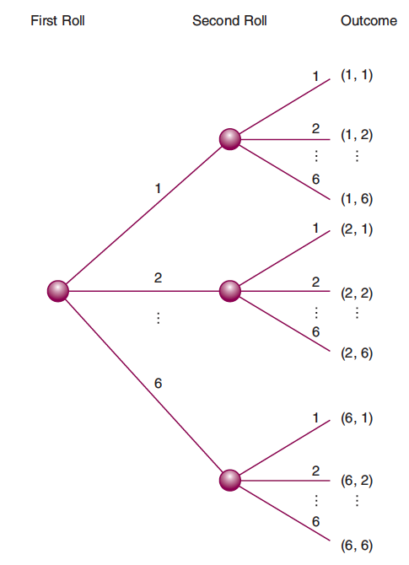
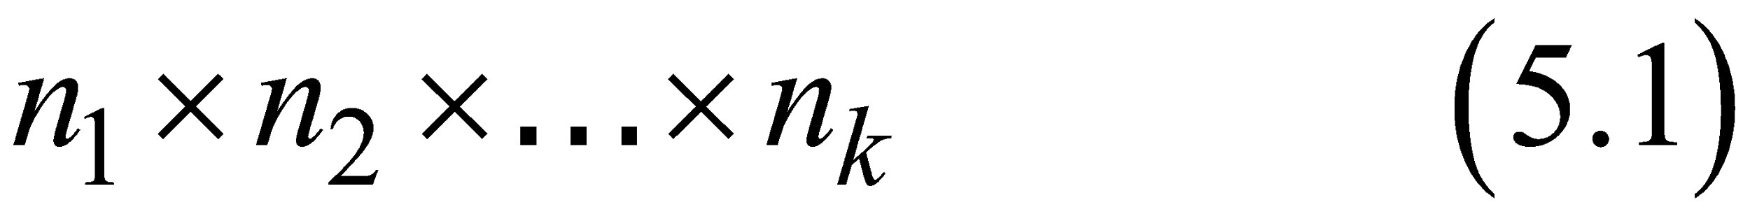
Example 5.1: Rolling Two Dice
Tree diagram
For an experiment with k steps, the number of outcomes is
For rolling two dice, we have 6 outcomes for the first roll, and 6 outcomes for the second roll. The total number of outcomes is 6 × 6 = 36.

Slide 5
Example 5.2: Selecting n Objects from N
In a group of five students, an instructor might wish to select three of them to make presentations.
The first student selected can be student 1, 2, 3, 4, or 5. However, if student 1 is selected first, then the second student can be 2, 3, 4, or 5. Then, if the second student selected is student 4, the third student can be 2, 3, or 5.

Slide 6
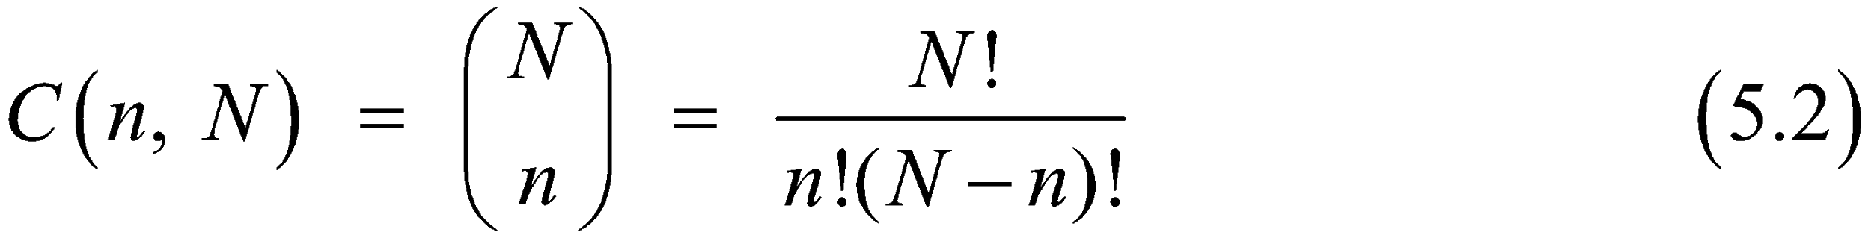
Combinations
When the order does not matter, we only want to count unique outcomes, which we call combinations.
The number of combinations for selecting n objects from a set of N is

Slide 7
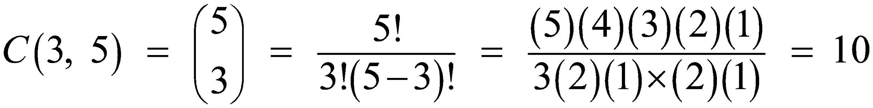
Example 5.3: Applying the Combinations Formula
In Example 5.2, the number of ways of selecting three students from a group of five is

Slide 8
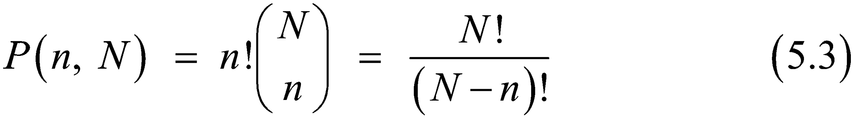
Permutations
If we want to select n objects from N and the order is important, then we call the outcomes permutations.
The number of permutations of n objects selected from N is

Slide 9
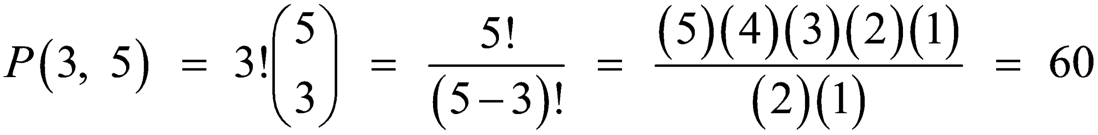
Example 5.4: Applying the Permutations Formula
Suppose we want to count the number of ways of selecting three students from a group of five where the order is important (for instance, knowing which student presents first, second, and third).

Slide 10
Probability Definitions
Probabilities may be defined from one of three perspectives:
Classical definition: probabilities can be deduced from theoretical arguments
Relative frequency definition: probabilities are based on empirical data
Subjective definition: probabilities are based on judgment and experience

Slide 11
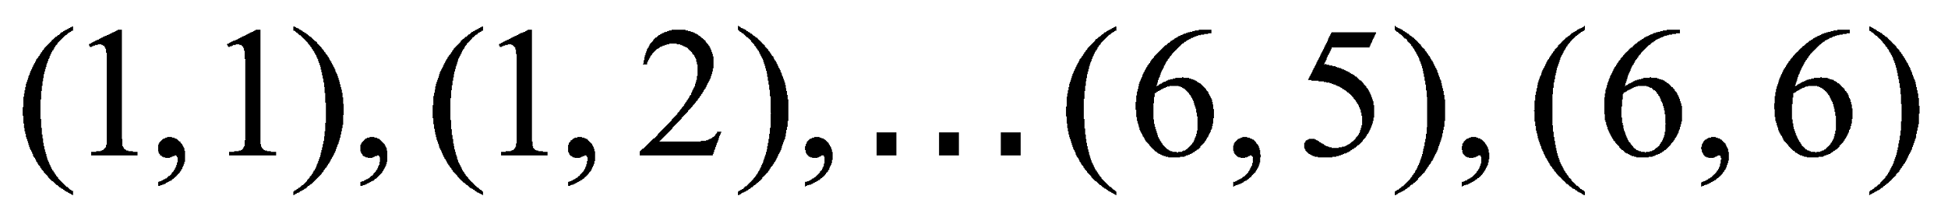
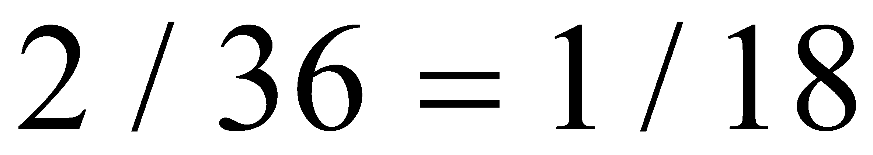
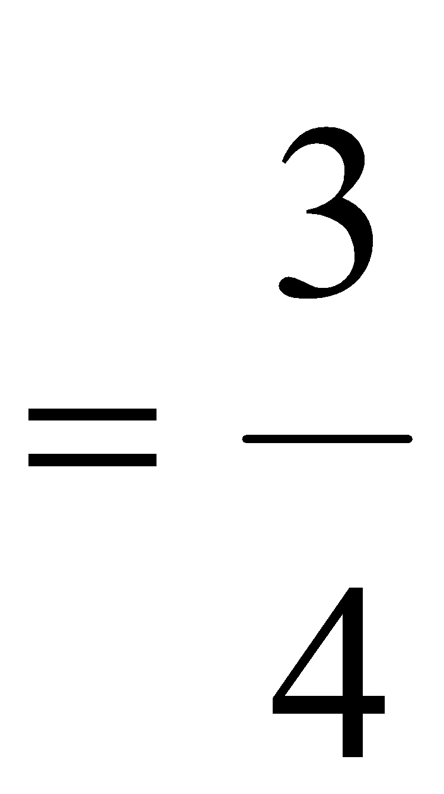
Example 5.5 Classical Definition of Probability
Roll 2 dice
36 possible rolls
Die Sum | Frequency
2 | 1
3 | 2
4 | 3
5 | 4
6 | 5
7 | 6
8 | 5
9 | 4
10 | 3
11 | 2
12 | 1
Sum | 36
Probability = number of ways of rolling a number divided by 36;
e.g., probability of a 3 is
Suppose two consumers try a new product.
Four outcomes:
like, like
like, dislike
dislike, like
dislike, dislike
Probability at least one dislikes product

Slide 12
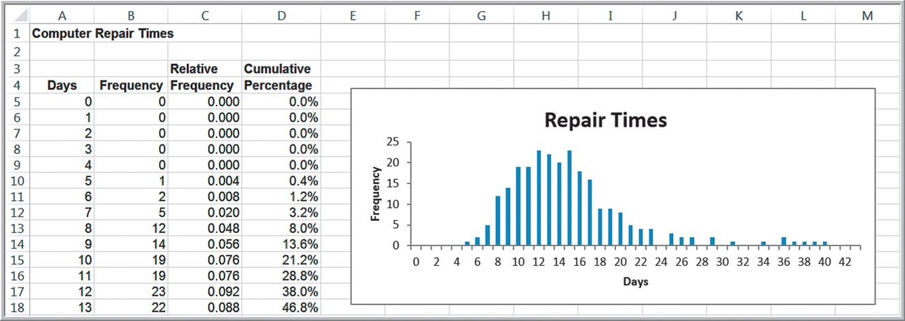
Example 5.6: Relative Frequency Definition of Probability
Use relative frequencies as probabilities.
Probability a computer is repaired in 10 days = 0.076

Slide 13
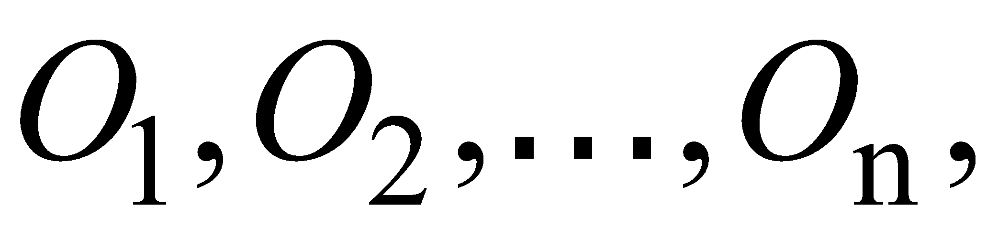

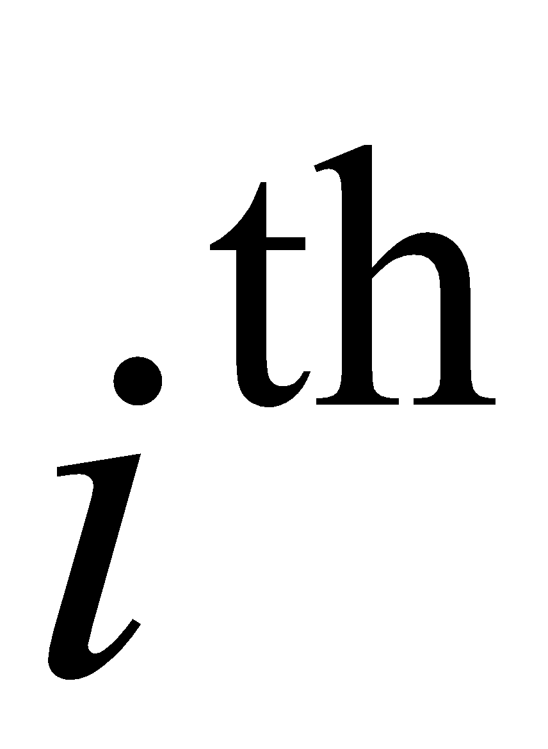
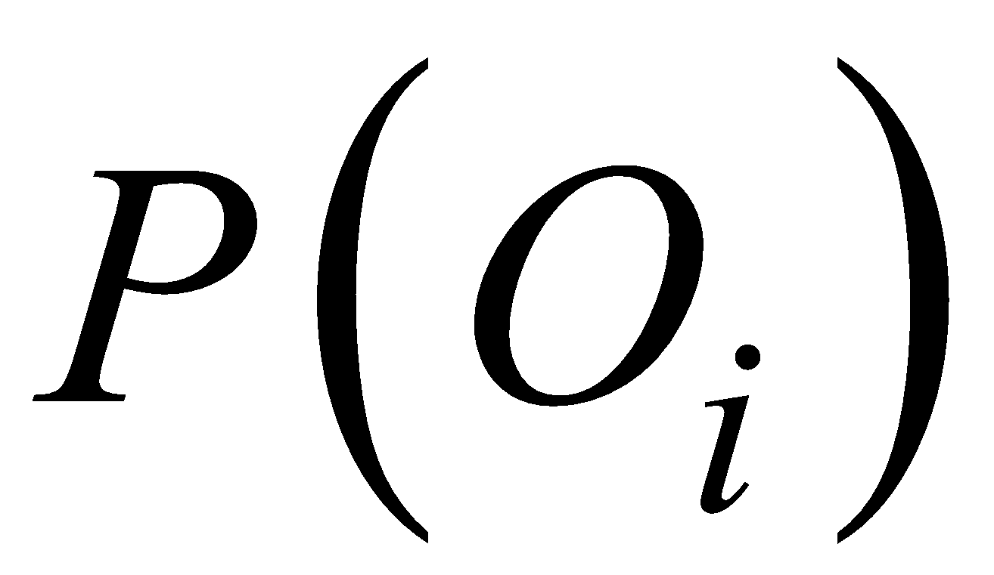
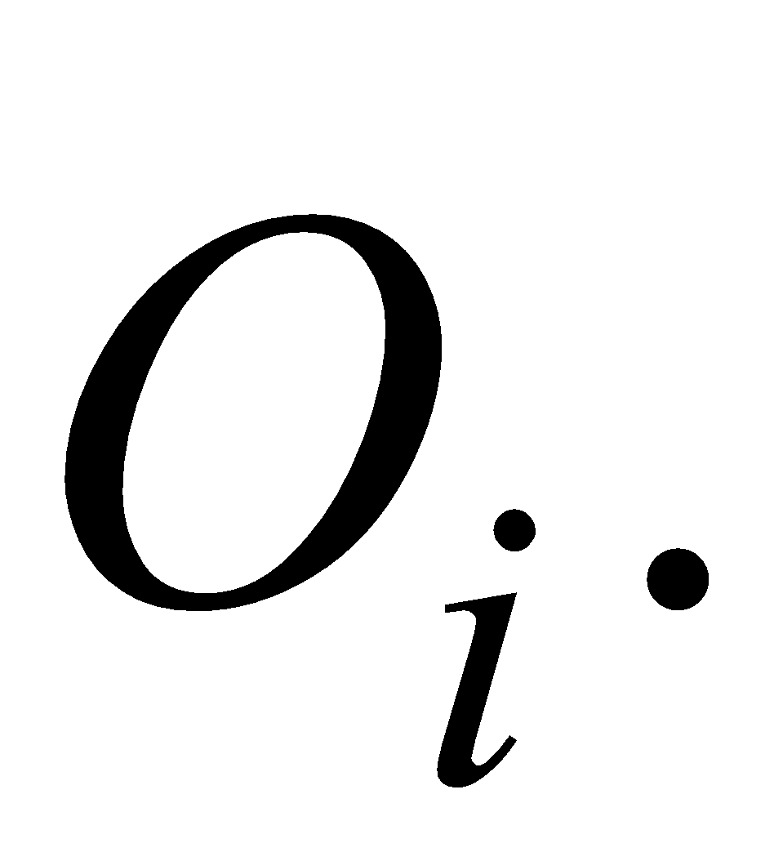
Probability Rules and Formulas
Label the n outcomes in a sample space as
where
represents the
outcome in the sample space. Let
be the probability associated with the outcome
The probability associated with any outcome must be between 0 and 1.
The sum of the probabilities over all possible outcomes must be equal to 1.

Slide 14
Probabilities Associated with Events
An event is a collection of one or more outcomes from a sample space.
Rule 1. The probability of any event is the sum of the probabilities of the outcomes that comprise that event.

Slide 15
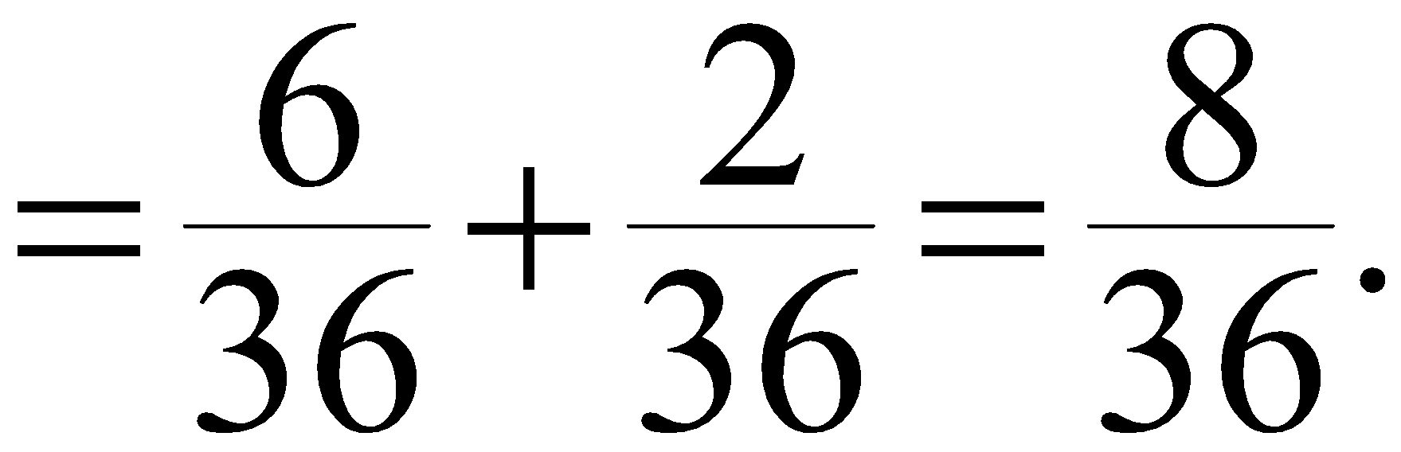
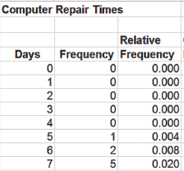
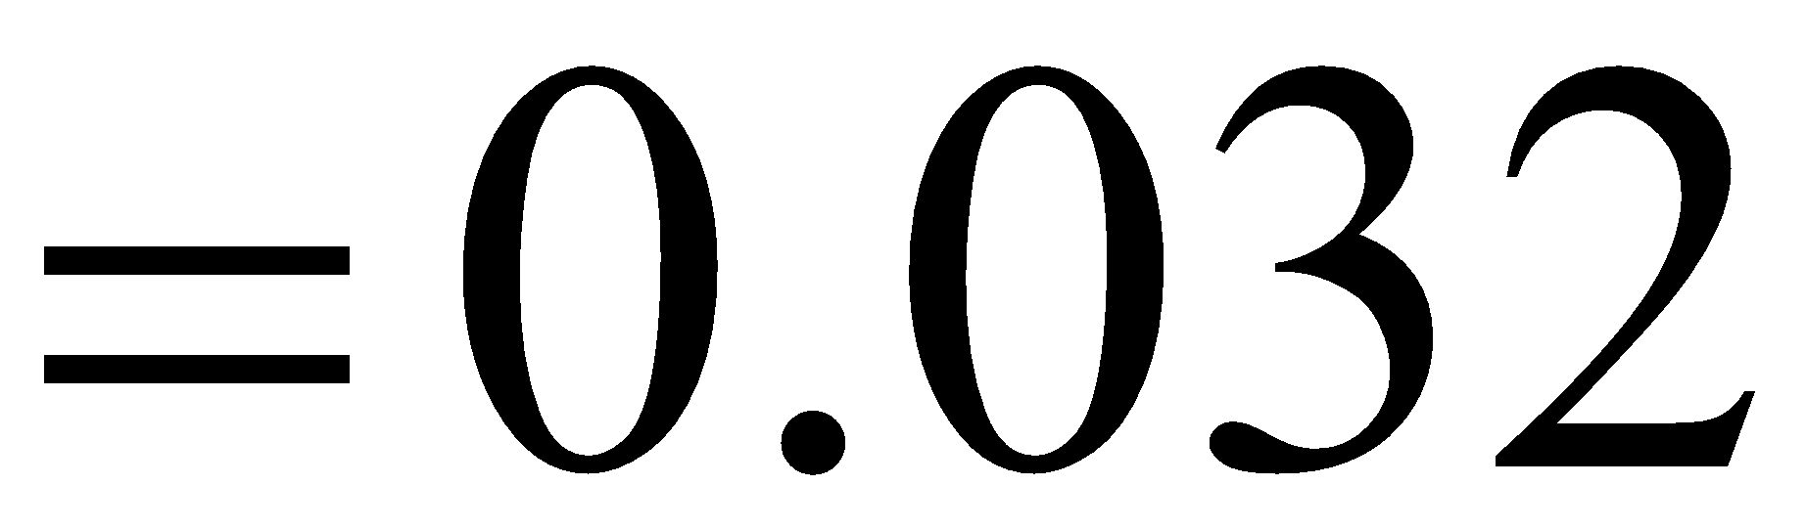
Example 5.7: Computing the Probability of an Event
Die Sum | Frequency
2 | 1
3 | 2
4 | 3
5 | 4
6 | 5
7 | 6
8 | 5
9 | 4
10 | 3
11 | 2
12 | 1
Sum | 36
Consider the events:
Rolling 7 or 11 on two dice
Probability
Repair a computer in 7 days or less
Probability =

Slide 16
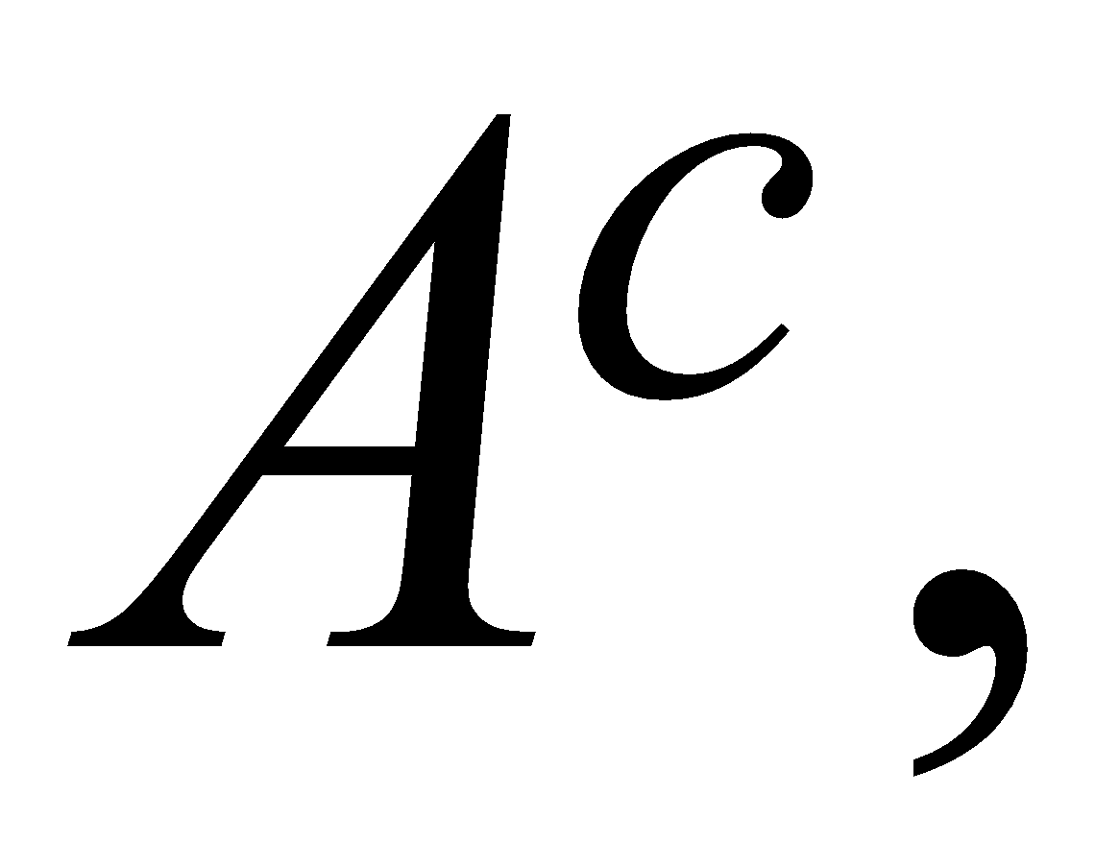
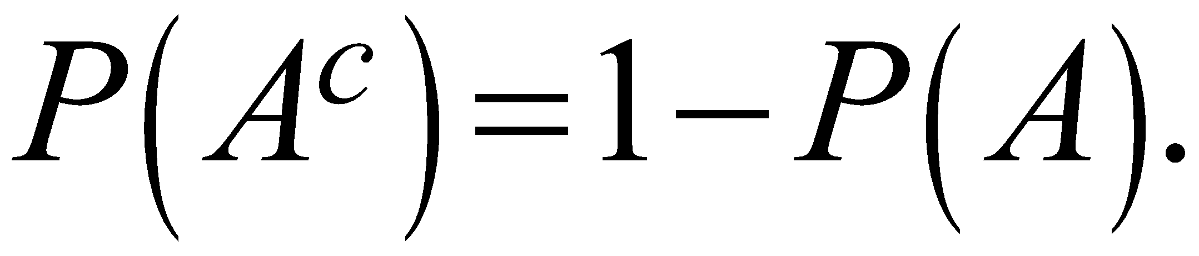
Complement of an Event
If A is any event, the complement of A, denoted
consists of all outcomes in the sample space
not in A.
Rule 2. The probability of the complement of any
event A is

Slide 17
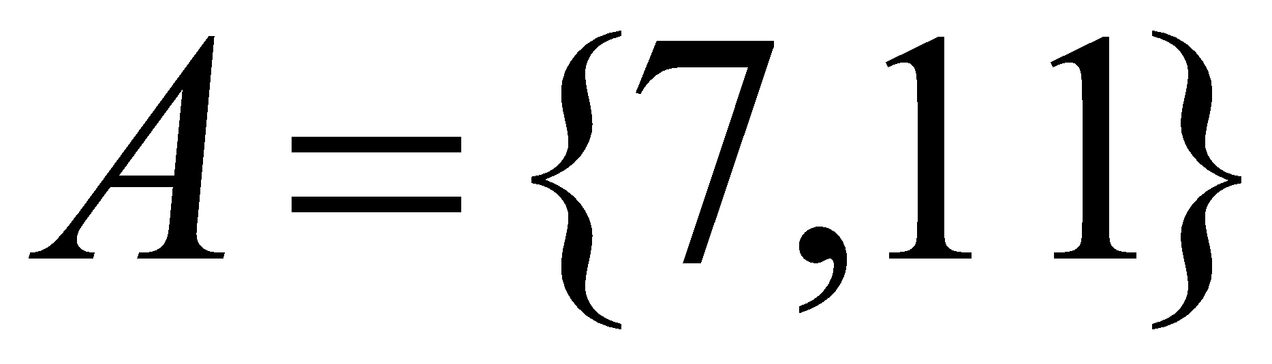
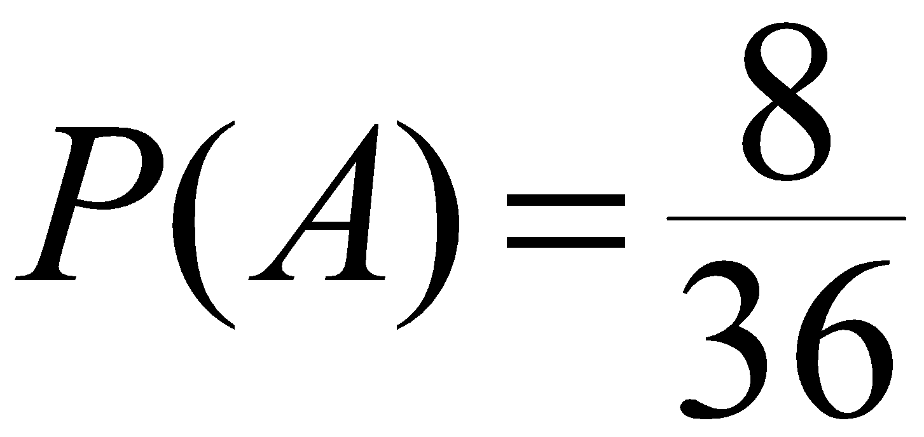
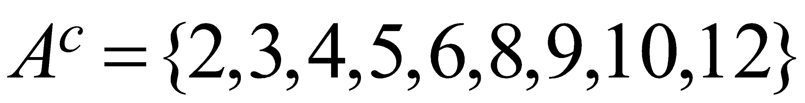
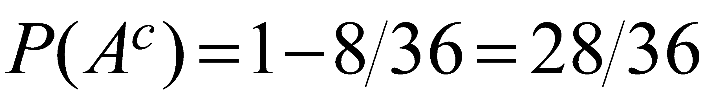
Example 5.8: Computing the Probability of the Complement of an Event
Dice Example:
Die Sum | Frequency
2 | 1
3 | 2
4 | 3
5 | 4
6 | 5
7 | 6
8 | 5
9 | 4
10 | 3
11 | 2
12 | 1
Sum | 36
Using Rule 2:

Slide 18
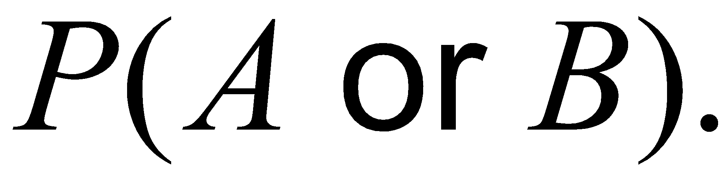
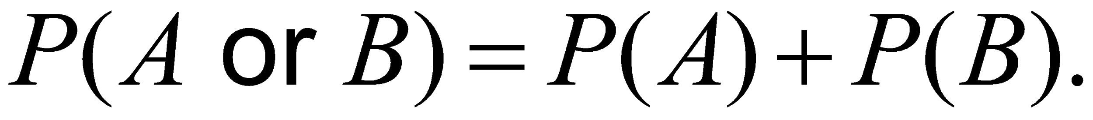
Union of Events
The union of two events contains all outcomes that belong to either of the two events.
If A and B are two events, the probability that some outcome in either A or B (that is, the union of A and B)
occurs is denoted as
Two events are mutually exclusive if they have no outcomes in common.
Rule 3. If events A and B are mutually exclusive,
then

Slide 19
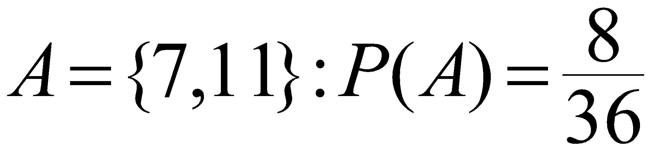
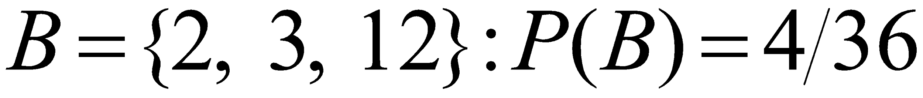
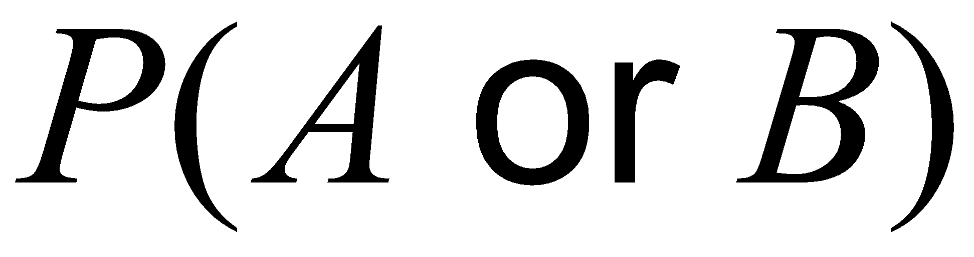
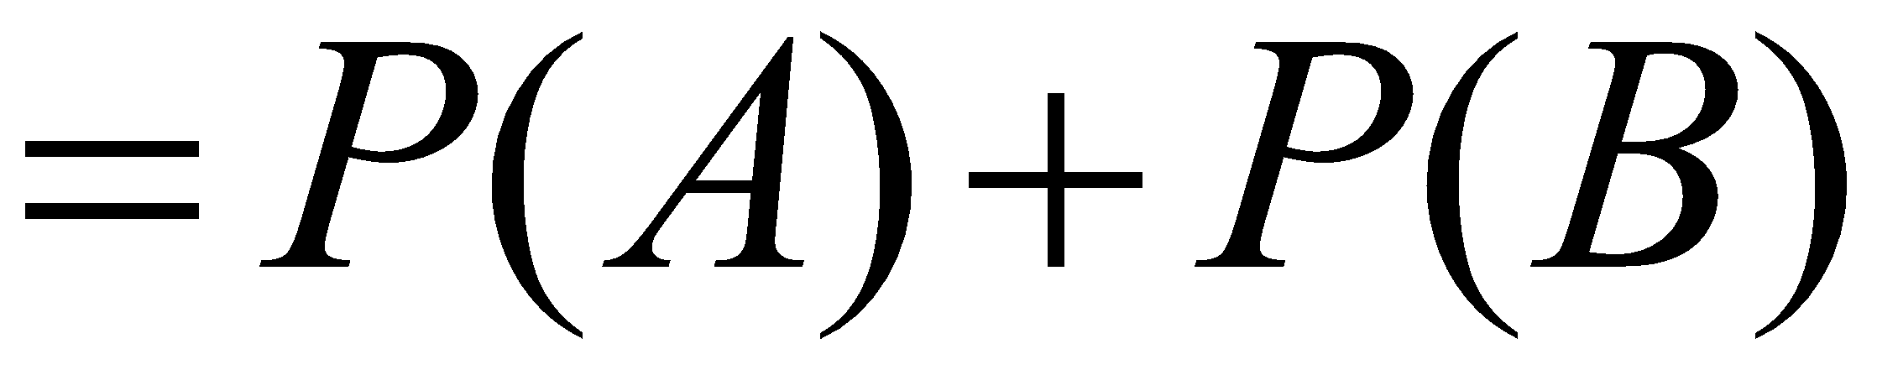
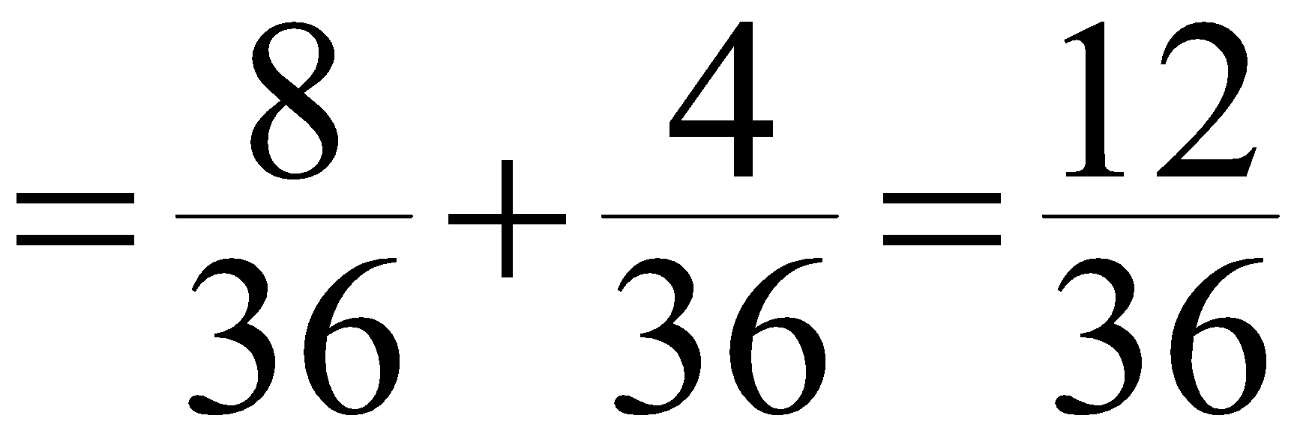
Example 5.9: Computing the Probability of Mutually Exclusive Events
Dice Example:
Die Sum | Frequency
2 | 1
3 | 2
4 | 3
5 | 4
6 | 5
7 | 6
8 | 5
9 | 4
10 | 3
11 | 2
12 | 1
Sum | 36
=Union of events A and B

Slide 20
Non-Mutually Exclusive Events
The notation (A and B) represents the intersection of events A and B - that is, all outcomes belonging to both A and B.
Rule 4. If two events A and B are not mutually
exclusive, then

Slide 21
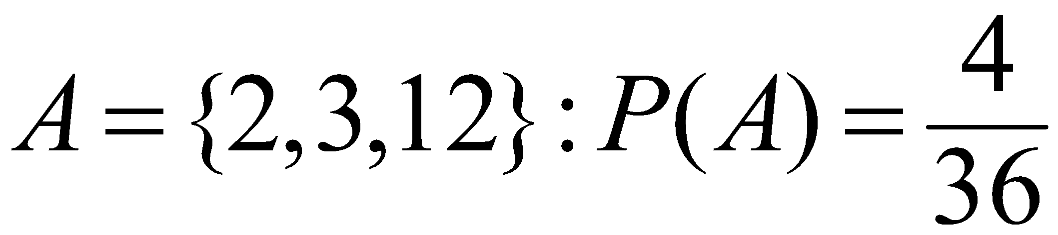
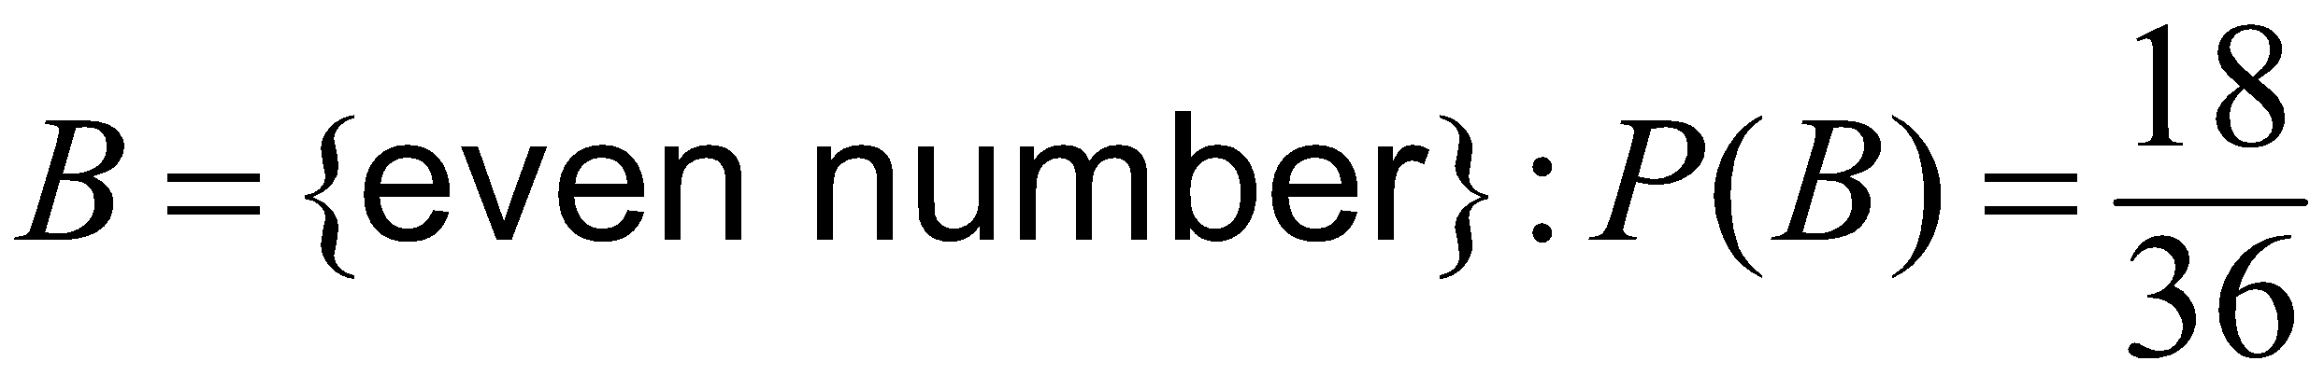
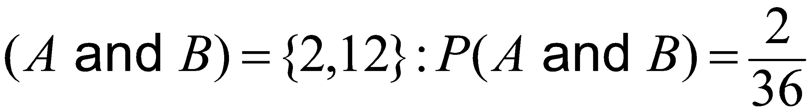
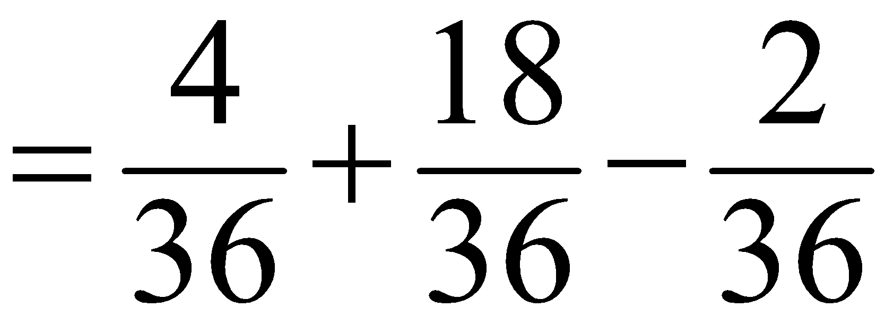
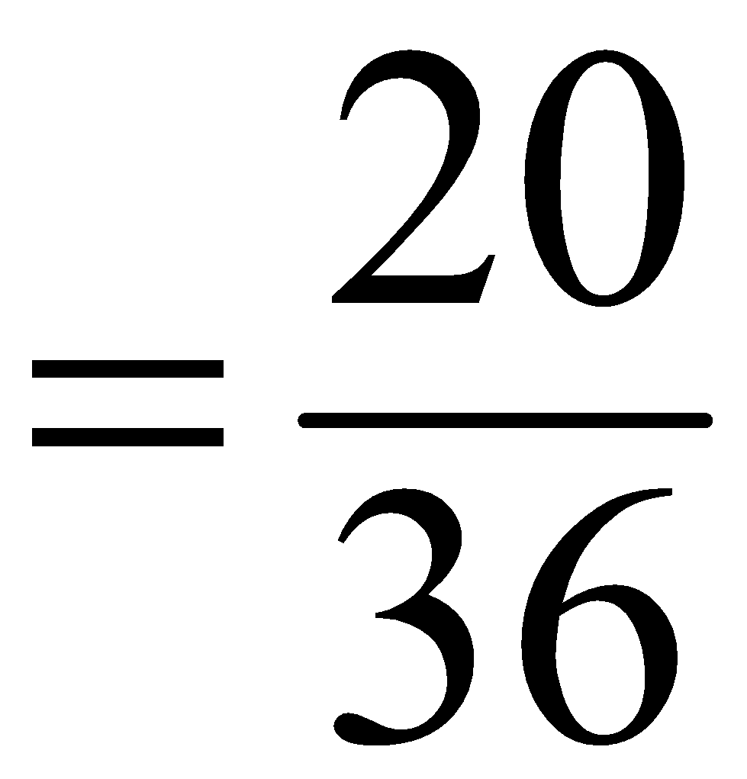
Example 5.10: Computing the Probability of Non-Mutually Exclusive Events
Dice Example:
Die Sum | Frequency
2 | 1
3 | 2
4 | 3
5 | 4
6 | 5
7 | 6
8 | 5
9 | 4
10 | 3
11 | 2
12 | 1
Sum | 36

Slide 22
Joint and Marginal Probability
The probability of the intersection of two events is called a joint probability.
The probability of an event, irrespective of the outcome of the other joint event, is called a marginal probability.

Slide 23
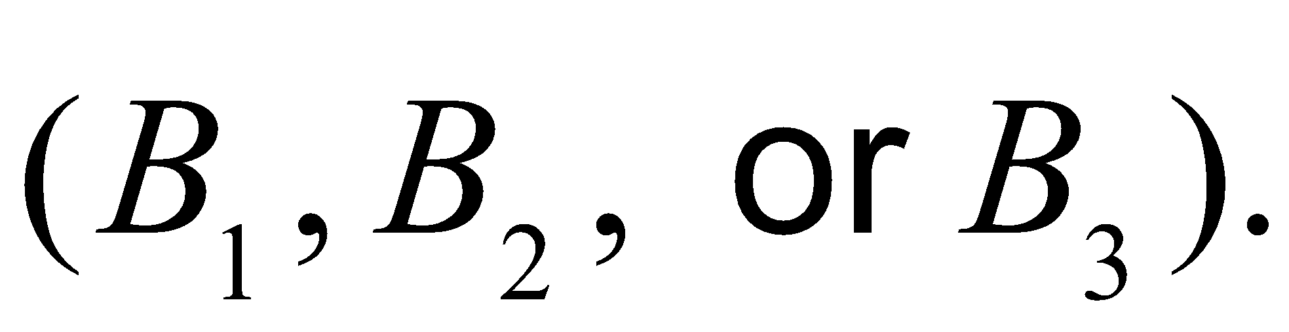
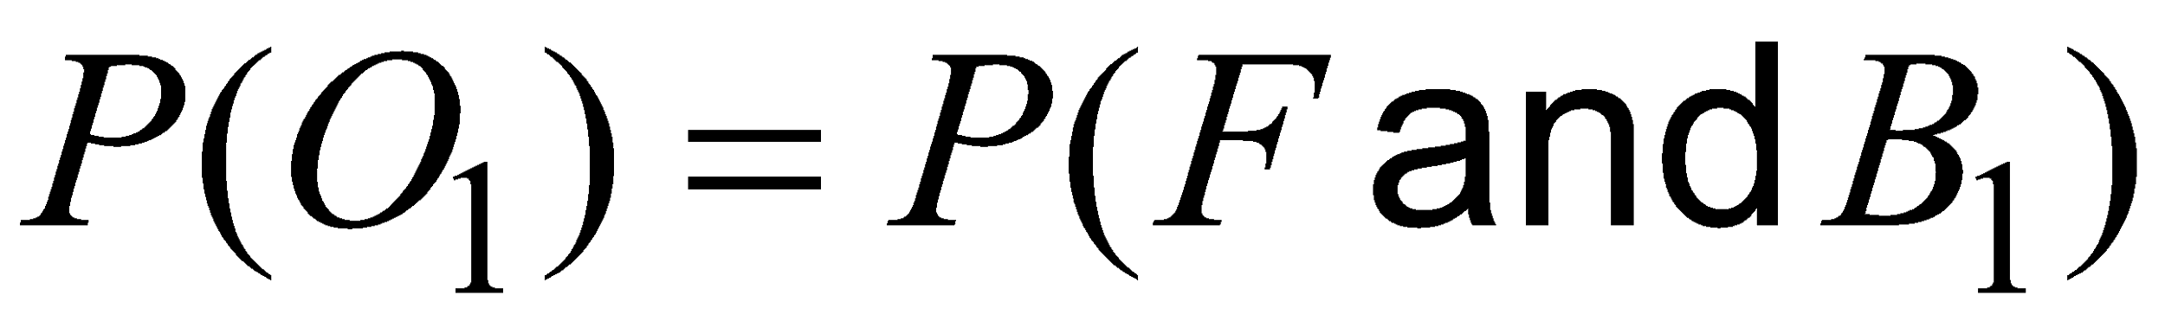
Application of Joint and Marginal Probability
A sample of 100 individuals were asked to evaluate their preference for three new proposed energy drinks in a blind taste test.
The sample space consists of two types of outcomes corresponding to each
individual: gender (F = female or M = male) and brand preference
Define a new sample space consisting of the outcomes that reflect the different combinations of outcomes from these two sample spaces.
The probability of each of these events is the intersection of the gender and brand
preference event. For example,

Slide 24
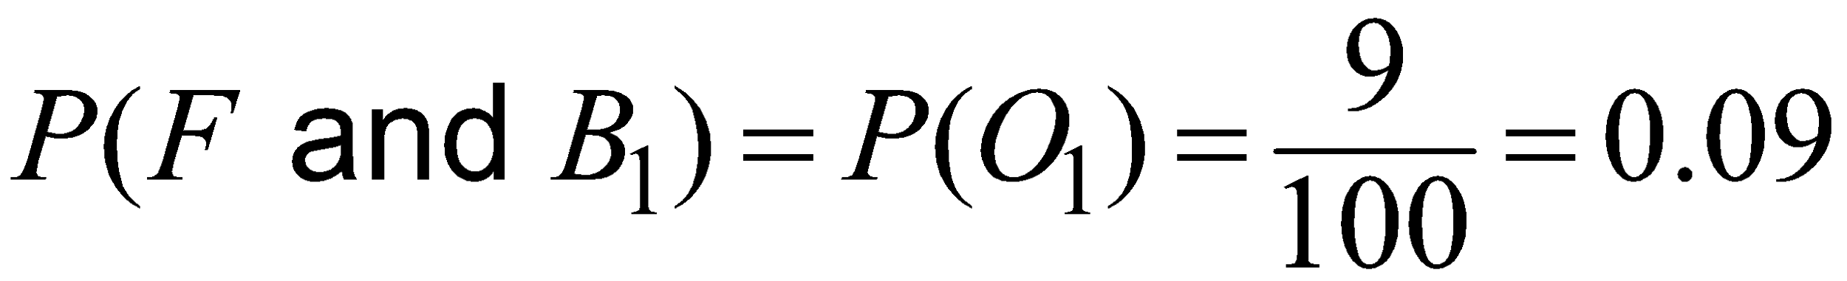
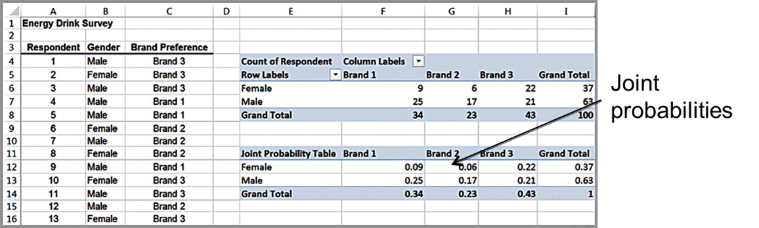
Example 5.11: Applying Probability Rules to Joint Events (1 of 3)
Energy Drink Survey
The joint probabilities of gender and brand preference are calculated by dividing the number of respondents corresponding to each of the six outcomes listed above by the total number of respondents, 100.
E.g.,

Slide 25
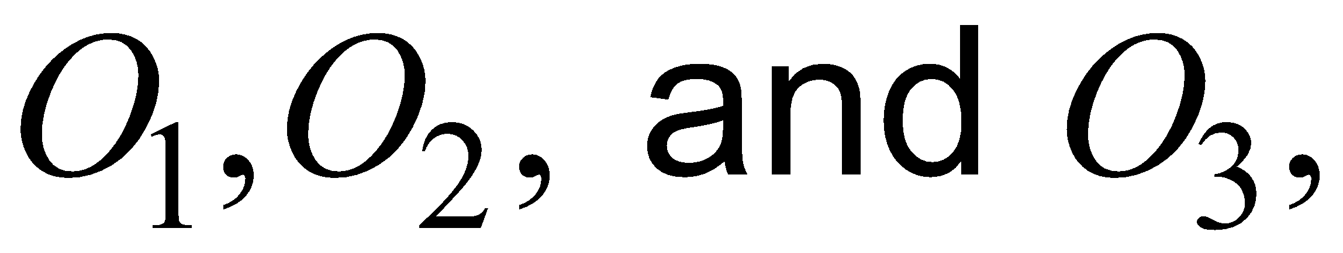
Example 5.11: Applying Probability Rules to Joint Events (2 of 3)
The marginal probabilities for gender and brand preference are calculated by adding the joint probabilities across the rows and columns
E.g., the event F, (respondent is female) is comprised
of the outcomes
and therefore
Joint Probability Table | Brand 1 | Brand 2 | Brand 3 | Grand Total
Female | 0.09 | 0.06 | 0.22 | 0.37
Male | 0.25 | 0.17 | 0.21 | 0.63
Grand Total | 0.34 | 0.23 | 0.43 | 1

Slide 26
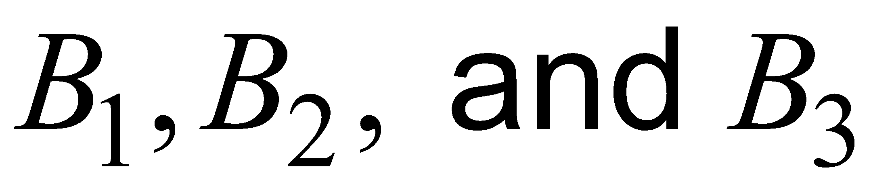
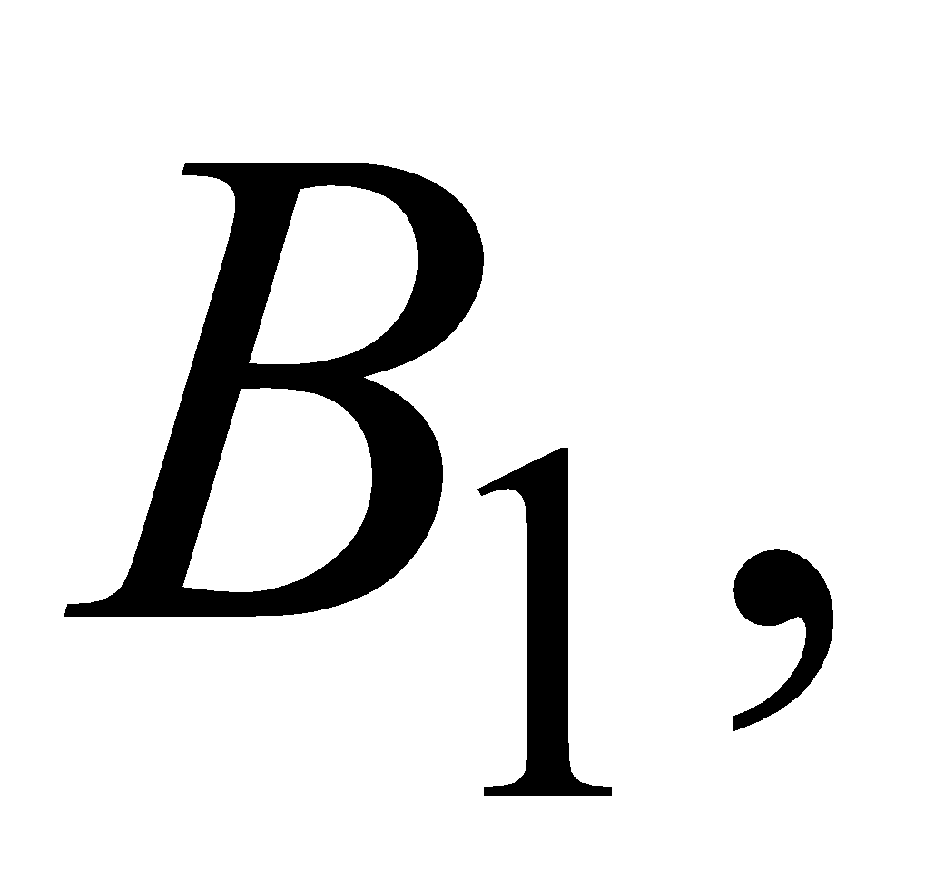
Example 5.11: Applying Probability Rules to Joint Events (3 of 3)
Events F and M are mutually exclusive, as are events
since a respondent may be only male or female and prefer exactly one of the three brands. We can use Rule 3 to find, for example,
Events F and
however, are not mutually exclusive because a
respondent can be both female and prefer brand 1. Therefore, using
Rule 4, we have
Joint Probability Table | Brand 1 | Brand 2 | Brand 3 | Grand Total
Female | 0.09 | 0.06 | 0.22 | 0.37
Male | 0.25 | 0.17 | 0.21 | 0.63
Grand Total | 0.34 | 0.23 | 0.43 | 1

Slide 27
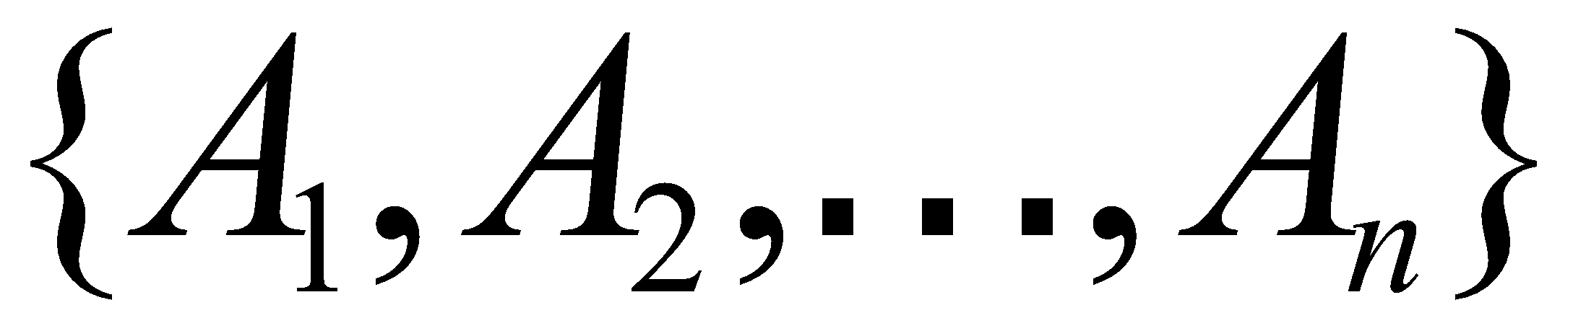
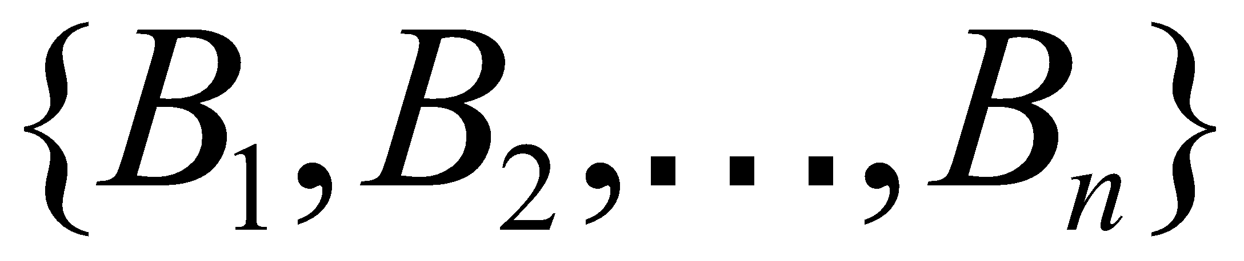
Joint/Marginal Probability Rule
Calculations of marginal probabilities leads to the following probability rule:
Rule 5. If event A is comprised of the outcomes
and event B is comprised of the
outcomes
then

Slide 28
Conditional Probability
Conditional probability is the probability of occurrence of one event A, given that another event B is known to be true or has already occurred.

Slide 29
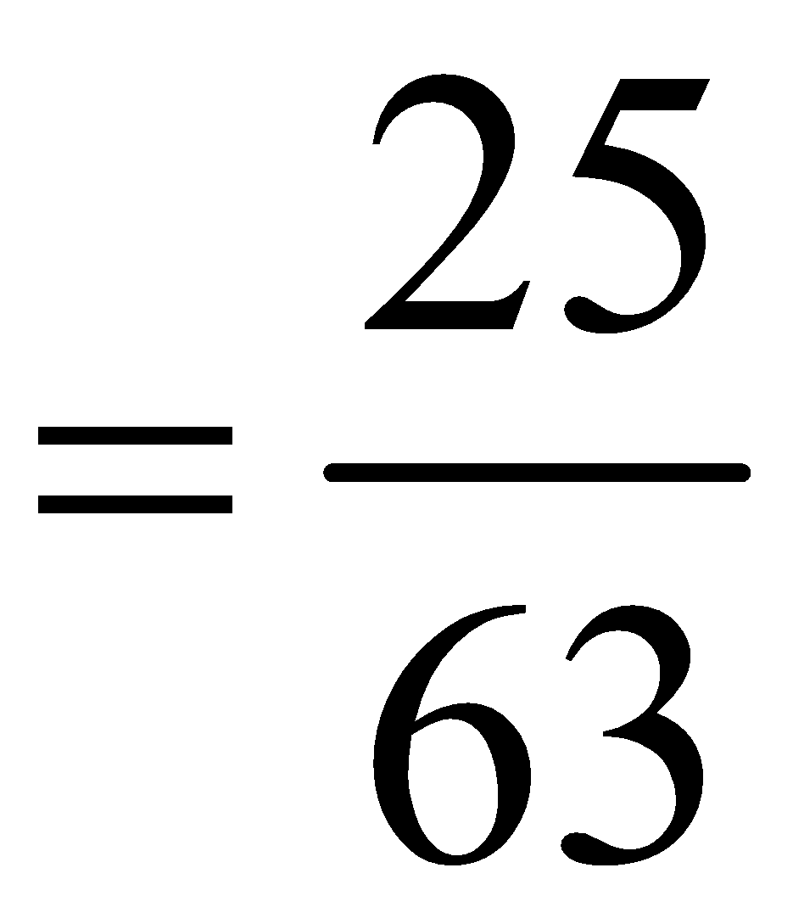
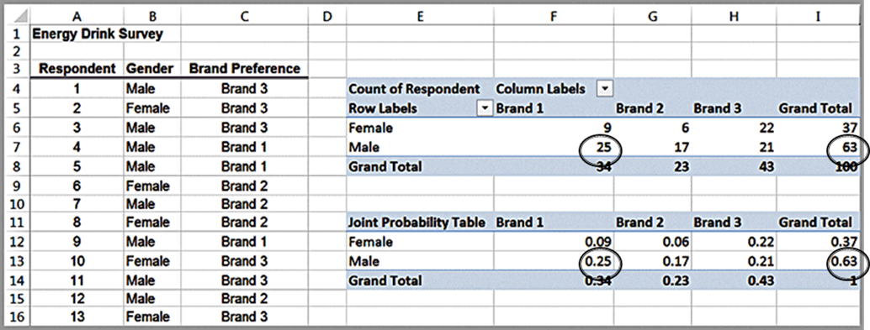
Example 5.12: Computing a Conditional Probability in a Cross-Tabulation
Suppose we know a respondent is male. What is the probability that he prefers Brand 1?
Using cross-tabulation: Of 63 males, 25 prefer Brand 1, so the
probability of preferring Brand 1 given that a respondent is male
Using joint probability table: divide the joint probability 0.25 (the probability that the respondent is male and prefers brand 1) by the marginal probability 0.63 (the probability that the respondent is male).

Slide 30
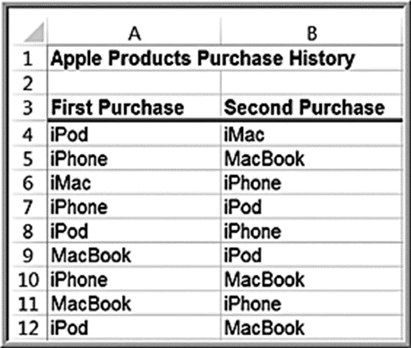
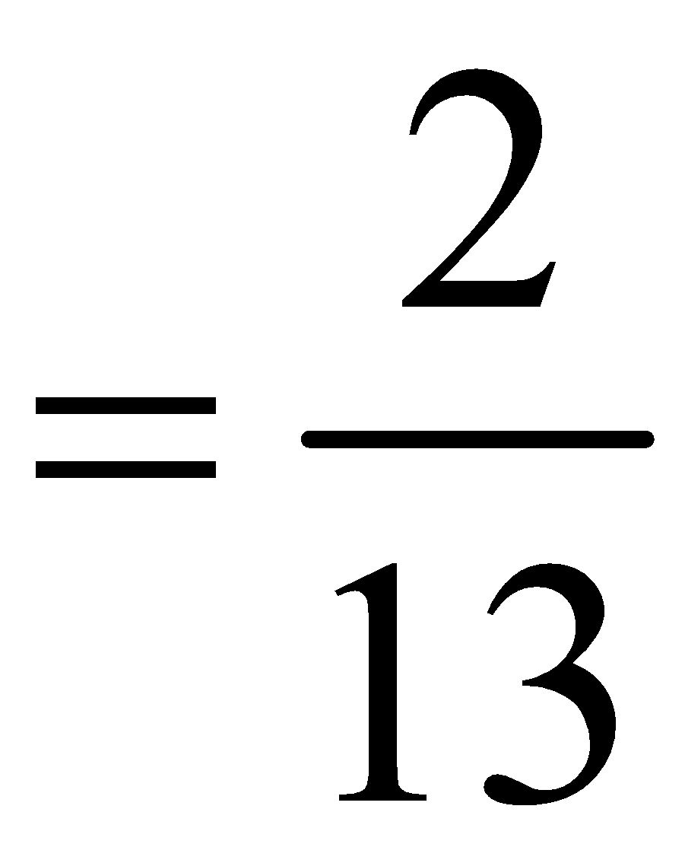
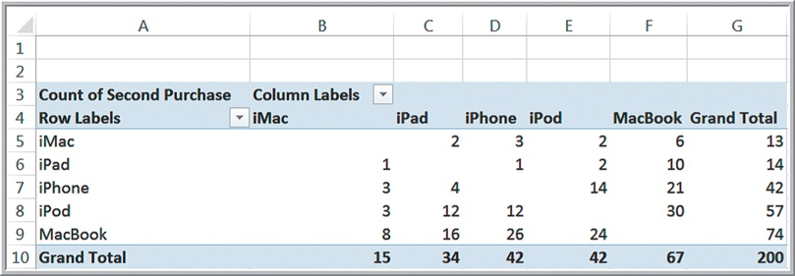
Example 5.13: Conditional Probability in Marketing
Apple Purchase History
The PivotTable shows the count of the type of second purchase given that each product was purchased first.
Probability of purchasing an iPad given that a customer already
purchased an iMac

Slide 31


Conditional Probability Formula
The conditional probability of an event A given that event B is known to have occurred is
We read the notation
as “the probability
of A given B.”

Slide 32



Example 5.14: Using the Conditional Probability Formula
Joint Probability Table | Brand 1 | Brand 2 | Brand 3 | Grand Total
Female | 0.09 | 0.06 | 0.22 | 0.37
Male | 0.25 | 0.17 | 0.21 | 0.63
Grand Total | 0.34 | 0.23 | 0.43 | 1
Summary of conditional probabilities:
Applications in marketing and advertising.

Slide 33




Variations of the Conditional Probability Formula
Note:
Multiplication law of probability:

Slide 34

Extension of the Multiplication Law
Suppose
are mutually exclusive
events whose union comprises the entire sample space. Then

Slide 35





Example 5.15: Using the Multiplication Law of Probability
“Texas Hold ‘Em” Poker
Probability of pocket aces (two aces in hand)
Ace on first card;
Ace on second card;

Slide 36

Independent Events
Two events A and B are independent if
Energy Drink Survey example: the probability of preferring a brand depends on gender.
Thus, we may say that brand preference and gender are not independent.

Slide 37





Example 5.16: Determining If Two Events Are Independent
Are Gender and Brand Preference Independent?
Because
Gender and Brand Preference are not independent.

Slide 38

Multiplication Law for Independent Events
If two events are independent, then we can simplify the multiplication law of probability in equation (5.7).
by substituting

Slide 39


Example 5.17: Using the Multiplication Law for Independent Events
Dice Rolls:
Rolling pairs of dice are independent events since they do not depend on the previous rolls.
Using formula (5.9):

Slide 40
Random Variables
A random variable is a numerical description of the outcome of an experiment.
A discrete random variable is one for which the number of possible outcomes can be counted.
A continuous random variable has outcomes over one or more continuous intervals of real numbers.

Slide 41
Example 5.18: Discrete and Continuous Random Variables
Examples of discrete random variables:
outcomes of dice rolls
whether a customer likes or dislikes a product
number of hits on a Web site link today
Examples of continuous random variables:
weekly change in D J I A
daily temperature
time between machine failures

Slide 42
Probability Distributions
A probability distribution is a characterization of the possible values that a random variable may assume along with the probability of assuming these values.
We may develop a probability distribution using any one of the three perspectives of probability: classical, relative frequency, and subjective.

Slide 43

Example 5.19: Probability Distribution of Dice Rolls

Slide 44
Empirical Probability Distributions
We can calculate the relative frequencies from a sample of empirical data to develop a probability distribution. Because this is based on sample data, we usually call this an empirical probability distribution.
An empirical probability distribution is an approximation of the probability distribution of the associated random variable, whereas the probability distribution of a random variable, such as one derived from counting arguments, is a theoretical model of the random variable.

Slide 45

Empirical Probability Distribution Example

Slide 46
Subjective Probability Distributions
We could simply specify a probability distribution using subjective values and expert judgment.
This is often done in creating decision models for phenomena for which we have no historical data.

Slide 47

Example 5.20: A Subjective Probability Distribution
Distribution of an expert’s assessment of how the D J I A might change next year.

Slide 48





Discrete Probability Distributions
For a discrete random variable X, the probability distribution of the discrete outcomes is called a probability mass function and is denoted by a
mathematical function,
The symbol
represents the
value of the random variable
X and
is the probability.
Properties:
the probability of each outcome must be between 0 and 1
the sum of all probabilities must add to 1

Slide 49



Example 5.21: Probability Mass Function for Rolling Two Dice
values of the random variable X, which
represents sum of the rolls of two dice

Slide 50


Cumulative Distribution Function
A cumulative distribution function,
specifies the probability that the random variable
X assumes a value less than or equal to a specified value, x; that is,

Slide 51


Example 5.22: Using the Cumulative Distribution Function
Probability of rolling a 6 or less
Probability of rolling between 4 and 8:

Slide 52


Expected Value of a Discrete Random Variable
The expected value of a random variable corresponds to the notion of the mean, or average, for a sample.
For a discrete random variable X, the expected
value, denoted
is the weighted average of all
possible outcomes, where the weights are the probabilities:

Slide 53

Example 5.23: Computing the Expected Value
Rolling two dice

Slide 54
Example 5.24: Expected Value on Television
The Apprentice
Teams were required to select an artist (mainstream or avant-garde) and sell their art for the most money possible. A simple expected value calculation would have easily predicted the winner.
Deal or No Deal
Contestant had 5 briefcases left with $100, $400, $1000, $50,000 or $300,000 in them.
Expected value of briefcases is $70,300.
Banker offered contestant $80,000 to quit, which was higher than the expected value. The probability of choosing the $300,000 briefcase was only 0.2, so the decision should have been easy to make.

Slide 55
Expected Value and Decision Making
The expected value is a “long-run average” and is appropriate for decisions that occur on a repeated basis.
For one-time decisions, however, you need to consider the downside risk and the upside potential of the decision.

Slide 56


Example 5.25: Expected Value of a Charitable Raffle
Cost of raffle ticket is $50.
1000 raffle tickets are sold.
Winning prize is $25,000.
If you played this game repeatedly over the long run, you would lose an average of $25.00 each time you play.
However, for any one game, you would either lose $50 or win $24,950.
Is the risk of losing $50 worth the potential of winning $24,950?

Slide 57

Example 5.26: Airline Revenue Management
Full and discount airfares are available for a flight.
Full-fare ticket costs $560.
Discount ticket costs $400.
X = ticket price paid
p = 0.75 (the probability of selling a full-fare ticket)
The airline should not discount full-fare tickets because the expected value of a full-fare ticket is greater than the cost of a discount ticket.
Break-even point:

Slide 58


Variance of a Discrete Random Variable
The variance,
of a discrete random
variable X is a weighted average of the squared deviations from the expected value:

Slide 59

Example 5.27: Computing the Variance of a Random Variable
Rolling two dice

Slide 60



Bernoulli Distribution
Two possible outcomes, “success” and “failure,” each with a constant probability of occurrence; p is the probability of a success and 1 − p is the probability of a failure.
Typically, x = 1 represents “success” and x = 0 represents “failure.”
Probability mass function:

Slide 61
Example 5.28: Using the Bernoulli Distribution
The Bernoulli distribution can be used to model whether an individual responds positively (x = 1), or negatively (x = 0) to a telemarketing promotion.
For example, if you estimate that 20% of customers contacted will make a purchase, the probability distribution that describes whether or not a particular individual makes a purchase is Bernoulli with p = 0.2.

Slide 62


Binomial Distribution
Models n independent replications of a Bernoulli experiment, each with a probability p of success.
X represents the number of successes in these n experiments.
Probability mass function:
Expected value

Slide 63

Example 5.29: Computing Binomial Probabilities
Suppose 10 individuals receive a telemarking promotion. Each individual has a 0.2 probability of making a purchase. Find the probability that exactly 3 of the 10 individuals make a purchase.
The probability distribution that x individuals out of 10 calls will make a purchase is:

Slide 64

Excel Binomial Distribution Function
If cumulative is set to true, then this function will provide cumulative probabilities; otherwise the default is false, and it provides values of
the probability mass function,

Slide 65

Example 5.30: Using Excel’s Binomial Distribution Function
The probability that exactly 3 of 10 individuals will make a
a purchase is P(x = 3): = BINOM.DIST(3,10,0.2, FALSE) = 0.20133.
The probability that 3 or fewer of 10 individuals will make
a purchase is P(x ≤ 3): = BINOM.DIST(3,10,0.2, TRUE) = 0.87913.

Slide 66

Shapes and Skewness of the Binomial Distribution
The binomial distribution is symmetric when p = 0.5; positively skewed when p < 0.5, and negatively skewed when p > 0.5.

Slide 67



Poisson Distribution
Models the number of occurrences in some unit of measure (often time or distance).
There is no limit on the number of occurrences.
The average number of occurrence per unit is a constant
denoted as
Probability mass function:
Expected value

Slide 68


Example 5.31: Computing Poisson Probabilities
Suppose the average number of customers arriving at a
Subway restaurant during lunch hour is
per hour.
The probability that exactly x customers arrive during the hour is given by the Poisson distribution with a mean of 12.

Slide 69
Excel Poisson Distribution Function
If cumulative is set to true, then this function will provide cumulative probabilities; otherwise the default is false, and it provides values of
the probability mass function,

Slide 70



Example 5.32: Using Excel’s Poisson Distribution Function
With
the probability that X = 1 is
The probability that

Slide 71

Continuous Probability Distributions
A probability density function is a mathematical function that characterizes a continuous random variable.

Slide 72



Properties of Continuous Probability Distributions
Properties
for all values of x
Total area under the density function equals 1.
Probabilities are only defined over intervals.
is the area under the density function
between a and b.

Slide 73



Uniform Distribution
The uniform distribution characterizes a continuous random variable for which all outcomes between a minimum (a) and a maximum (b) are equally likely.
Density function:
Cumulative distribution function:
Expected value

Slide 74



Example 5.33: Computing Uniform Probabilities
Sales revenue for a product varies uniformly each week between $1000 and $2000.
Probability that sales revenue will be less than x = $1,300.
Probability that revenue will be between $1,500 and $1,700.

Slide 75

Discrete Uniform Distribution
A variation of the uniform distribution is one for which the random variable is restricted to integer values between a and b (also integers); this is called a discrete uniform distribution.
Example: roll of a single die. Each of the
numbers 1 through 6 have a
probability
of occurrence.

Slide 76




Normal Distribution
is a bell-shaped curve.
Characterized by 2 parameters:
Properties
Symmetric
Mean = Median = Mode
Range of X is unbounded.
Empirical rules apply

Slide 77

Excel Normal Distribution Function
calculates the cumulative probability.
If cumulative is set to false, the function simply
calculates the value of the density function
which has little practical application.

Slide 78



Example 5.34 Using the N O R M.D I S T Function to Compute Normal Probabilities
The distribution for customer demand (units per month) is normal with mean = 750 and standard deviation = 100.
Find the probability that demand will be:
at most
exceed
be between

Slide 79


Example 5.34: Question 1
Probability that demand will be at most 900 units, or

Slide 80


Example 5.34: Question 2
Probability that demand will exceed 700 units, or

Slide 81


Example 5.34: Question 3
Probability that demand will be between 700 and 900, or

Slide 82
The N O R M.I N V Function
Suppose that we know the cumulative probability but don’t know the value of x. The Excel function
provides the x value for a given cumulative probability.

Slide 83


Example 5.35: Using the N O R M.I N V Function
What level of demand would be exceeded at most 10% of the time?
Find x such that

Slide 84


Standard Normal Distribution
A standard normal distribution is a normal distribution with a mean of 0 and standard deviation of 1.
A standard normal random variable is denoted by Z.
The scale along the z-axis represents the number of standard deviations from the mean of zero.
The Excel function
finds probabilities for the
standard normal distribution.

Slide 85





Example 5.36: Computing Probabilities with the Standard Normal Distribution
Verify the empirical rules using Excel.
Example: The probability within one standard deviation
of the mean is
is found by the formula

Slide 86




Using Standard Normal Distribution Tables
Table 1 of Appendix A
Z | .00 | .01 | .02 | .03 | .04 | .05 | .06 | .07 | .08 | .09
−3.9 | .00005 | .00005 | .00004 | .00004 | .00004 | .00004 | .00004 | .00004 | .00003 | .00003
−3.8 | .00007 | .00007 | .00007 | .00006 | .00006 | .00006 | .00006 | .00005 | .00005 | .00005
−3.7 | .00011 | .00010 | .00010 | .00010 | .00009 | .00009 | .00008 | .00008 | .00008 | .00008
−3.6 | .00016 | .00015 | .00015 | .00014 | .00014 | .00013 | .00013 | .00012 | .00012 | .00011
−3.5 | .00023 | .00022 | .00022 | .00021 | .00020 | .00019 | .00019 | .00018 | .00017 | .00017
−3.4 | .00034 | .00032 | .00031 | .00030 | .00029 | .00028 | .00027 | .00026 | .00025 | .00024
−3.3 | .00048 | .00047 | .00045 | .00043 | .00042 | .00040 | .00039 | .00038 | .00036 | .00035
We may compute probabilities for any normal random variable X
having a mean
and standard deviation
by converting it to a
standard normal random variable Z:

Slide 87


Example 5.37: Computing Probabilities with Standard Normal Tables
From Example 5.34, what is the probability that demand will be at least
z | .00
0.0 | .5000
0.1 | .5398
0.2 | .5793
0.3 | .6179
0.4 | .6554
0.5 | .6915
0.6 | .7257
0.7 | .7580
0.8 | .7881
0.9 | .8159
1.0 | .8413
1.1 | .8643
1.2 | .8849
1.3 | .9032
1.4 | .9192
1.5 | .9332
Using Table 1 in Appendix A, we find:

Slide 88


Exponential Distribution
Models the time between randomly occurring events
Density function:
Cumulative distribution function:
Mean
If the number of events occurring during an interval of time has a Poisson distribution, then the time between events is exponentially distributed.

Slide 89
Excel Exponential Distribution Function
As with other Excel probability distribution functions, cumulative is either true or false, with true providing the cumulative distribution function.

Slide 90





Example 5.38: Using the Exponential Distribution
The mean time to failure of a critical engine component is
hours. What is the probability of failing before 5000 hours?

Slide 91

Triangular Distribution
The triangular distribution is defined by three parameters: the minimum, a; maximum, b; and most likely, c.
By varying the most likely value, the triangular distribution can be symmetric or skewed in either direction

Slide 92
Triangular Distribution Properties
The triangular distribution is often used when no data are available to characterize an uncertain variable and the distribution must be estimated judgmentally.

Slide 93
Data Modeling and Distribution Fitting
Using sample data may limit our ability to predict uncertain events that may occur because potential values outside the range of the sample data are not included.
A better approach is to identify the underlying probability distribution from which sample data come by “fitting” a theoretical distribution to the data and verifying the goodness of fit statistically.
Examine a histogram for clues about the distribution’s shape.
Look at summary statistics such as the mean, median, standard deviation, coefficient of variation, and skewness.

Slide 94

Example 5.39: Analyzing Airline Passenger Data
Sample data on passenger demand for 25 flights
The histogram shows a relatively symmetric distribution. The mean, median, and mode are all similar, although there is moderate skewness. A normal distribution is not unreasonable.

Slide 95

Example 5.40: Analyzing Airport Service Times
Sample data on service times for 812 passengers at an airport’s ticketing counter
It appears to be exponential, but there is a difference between the mean and standard deviation, suggesting that it might be some other distribution.

Slide 96
Goodness of Fit
The basis for fitting data to a probability distribution is a statistical procedure called goodness of fit.
Goodness of fit attempts to draw a conclusion about the nature of the distribution.

Slide 97
Chi-Square Goodness of Fit Test
The chi-square goodness of fit test can be used to determine whether sample data are representative of some probability distribution.
The chi-square test can be applied to many distributions; the only modification to the procedure that must be made is to use the proper function to find the cumulative probabilities of the observed frequency distribution.

Slide 98

Example 5.41: Determining Normality for Airline Passenger Demand Data (1 of 2)
Start with the frequency distribution of the data; these are the observed frequencies.
Find the cumulative probability corresponding to the upper limit for each bin, assuming a normal distribution with the sample mean and sample standard deviation of the data.
Find the probability associated with each bin using formula (5.17).
Multiply the bin probabilities by the number of observations to obtain the expected frequencies.

Slide 99
Example 5.41: Determining Normality for Airline Passenger Demand Data (2 of 2)
Compute the difference between the observed and expected frequencies for each bin, square the result, and divide by the expected frequency for each bin.
Sum the chi-square calculations for all bins (chi-square statistic).
Compute the chi-square critical value using the function
Compare the chi-square statistic with the critical value. If the chi-square statistic is less than or equal to the critical value, then conclude that the data can be reasonably assumed to be normal.

Slide 100


Using the C H I S Q.I N V.R T Function
The number of degrees of freedom
used in the
function depends on the type of distribution you are
fitting.
In general, degrees of freedom is the number of bins minus one minus the number of parameters of the distribution that are estimated from the data. For the normal distribution, we need to estimate two parameters - the mean and standard deviation; thus, degrees of freedom equals the number of bins minus 3 (see step 7 in Example 5.41). For the exponential distribution, we need only estimate one parameter, lambda, so the degrees of freedom are the number of bins minus 2.

